Slide 1
Welcome to Developing Student Led Mathematical Discussions
Presented by Hilda Castillo and
Michele Appleby

Slide 2
Introductions
Hilda Castillo & Michele Appleby
32 years combined teaching experience in 4-8th grade in Ontario Montclair School District.
Participants of Algebraic Concepts for Elementary Students (ACES) since summer of 2010 facilitated by California State University of San Bernardino.
This work was supported by ACES - sponsored by the National Science Foundation, Ontario-Montclair School District, and the Center for Enhancement of Mathematics Education at CSU San Bernardino.

Slide 3
What is Common Core State Standards Mathematics (CCSS-M)?
We are faced with a new challenge called Common Core.
What is Common Core?
Write what you know about Common Core.
Audience’s thoughts...

Slide 4
Our Thoughts on Common Core
Common Core is the paradigm shift from the previous California State Standards to CCSS.
While the content is somewhat different, even more importantly the expectations of teachers and students are different in major ways.
Direct Instruction is not obsolete but will help supplement student learning.
We are in an era where student critical thinking is the expectation from CCSS.

Slide 5
Our Story
Direct Instruction is traditional for many teachers; therefore, comfortable.
This is how we were taught and trained.
It is more familiar.
Common Core is scary.
Change can be scary.
It is a shift in thinking about K-12 mathematics and mathematics instruction; this will be challenging.
There will be a tendency to revert back to familiar methods of instruction.

Slide 6
Our Story continued...
We have pressure from administrators on standardized testing.
Teachers and parents pressure students to perform well on Benchmarks and CST.
We feel pressure to focus more on the skills aspects of the standards than the concept.
Teaching conceptually is outside our comfort zone.

Slide 7
Consider the Following...
Student-led discussions is a strategy that will support students to think critically.
Direct Instruction is still a strategy that can be used to develop students’ skills.

Slide 8
What Role Does the Teacher Play in CCSS?
The teacher’s role is shifting. To be more successful with CCSS, teachers need to facilitate learning instead of providing information.
Student-led discussions is a strategy that lends itself to shifting this role.
Modeling student led discussions is the best way to facilitate one.

Slide 9
Quick Write
What do you think is a math discussion? (Brainstorm)
Discuss with your partner how you use math discussions in your class?
Everyone conducts a math discussion differently.
Let’s try it out a problem…

Slide 10
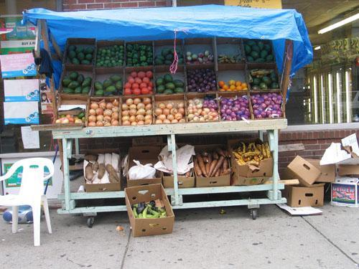
The Fruit Stand Problem

Slide 11
Guidelines for the Discussion of the Fruit Stand
DO NOT USE YOUR PENCIL!!!
Each person will receive a clue.
You will be given 1 minute to read your clue quietly to yourself.
Read your clue at least 3 times and be prepared to share with your group.
When you are prepared turn your paper over.

Slide 12
Discussing the Fruit Stand Problem
Take turns and share your clues with the group. Use pencils if necessary to take notes.
Put your pencil down when you are done discussing your clues and taking notes.
Quiet think time. No pencils. (2 minutes).
Think of how to solve your problem.

Slide 13
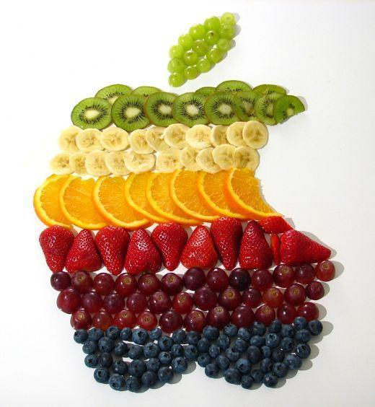
Problem Solving Time
No pencils.
Collaboration time: Share your thoughts on how you would solve the problem. It could be a strategy or process. (2 minutes)
Using pencils, solve the problem as a group. The group may come up with more than one way to solve the problem.
You may use any tools that you deem helpful.
Raise your hand when you are done.

Slide 14
Questions/Extensions
When you are finished, answer the following questions on your paper.
Will your answer yield exactly a $5 profit? Explain why or why not.
What issues would Oscar and Nathan run into by charging the price you found per piece of fruit?

Slide 15
Challenge Questions
If you finish early, select one of the bonus questions. Raise your hand when you are done with the Bonus Question.
Do you make more profit from apples or bananas?
Suppose you wanted your profit to increase from $5 dollars to $13 dollars. What will be the new price per fruit?
Suppose the cost of the bananas doubled in price. What will the new price per fruit be?

Slide 16
Exit Card
Describe the mathematical thinking or a mathematical strategy that you learned from someone else from your group.

Slide 17
Reflection on activity
Answer these questions with your group.
How does this activity promote mathematical discussions?
What are your thoughts on the mathematical discussions?
What did we do to help facilitate the discussion when you were stuck on the problem?

Slide 18
Look at Talk Moves
Put a star by the question stems that you think you would like to try in your classroom.
You will watch a video. Look at the questioning strategy guide and identify which questioning techniques the teacher uses in the video.

Slide 19
Debrief Video
What questions (Talk Moves) does the teacher ask to help facilitate the group discussions?
Revoicing
Repeating
Reasoning
Adding on
Waiting

Slide 20
The Art of Questioning ...courtesy of Algebraic Concepts for Elementary Students (ACES)
Helping students work to make sense of mathematics.
Helping students to rely more on them selves to determine whether something is mathematically correct.
Helping students learn to reason mathematically.
Helping students learn to conjecture, invent, and solve problems.
Helping students to connect mathematics, its ideas, and its applications.

Slide 21
Brief Video Demonstrating Questioning Strategies

Slide 22
Assessments
How do the questioning strategies help assess the students?
Teacher listens to what the kids say.
The formative assessment through asking questions helps the teacher gather information to know where the kids are at in their thinking.
Also helps you guide the class or clear up any misconceptions.

Slide 23
Identify which Standards for Mathematical Practice (SMP) were addressed today.
Make sense of problems and persevere in solving them.
Reason abstractly and quantitatively.
Construct viable arguments and critique the reasoning of others.
Model with mathematics.
Use appropriate tools strategically.
Attend to precision.
Look for and make use of structure.
Look for and express regularity in repeated reasoning.

Slide 24
Conclusion
In your groups, discuss what mathematical discussions would look like in your class.
What do you need to do to make this transition to mathematical discussions?
How can this strategy benefit all students such as EL, EO, GATE, or special ed ?

Slide 25
Closing Thoughts
With Common Core, you move slow to move fast.
Student-led discussions is not a solution to your instructional struggles; it is a strategy.
We would like to thank everyone for joining us today. Should you have any questions for us, please feel free to contact us at michele.appleby@omsd.k12.ca.us and hilda.castillo@omsd.k12.ca.us
Thank you for joining us today! Have a terrific rest of your day!
Raffle

