Slide 1
Transitioning to the Common Core: MDTP Written Response Items
California Mathematics Council – South Conference
November 2, 2013
Bruce Arnold, MDTP Director
Notes:
MDTP written response materials help improve students’ ability to think and communicate effectively about mathematics. We will explore a written response item in depth to learn how it can diagnose and support student misunderstandings and errors.

Slide 2
Session Highlights
Description of MDTP written response items
Explore written response items
How written response items support the CCSS Standards for Mathematical Practice

Slide 3
Written Response Items: Objectives
Primary
Help improve students’ abilities to think and communicate effectively about mathematics
Provide teachers with a more accurate and detailed view of each student’s conceptual grasp of a topic
Stimulate instructional activities
Secondary
Help evaluate students’ written math work
Strengthen students’ understanding of math
Promote examination of student work by teachers

Slide 4
Written Response Items: Components
Master copy of problem
Essence Statement
General scoring rubric
Specific scoring rubric
Notes:
REFER to AR12COMP handout.
Print and copy master and distribute to students for work in class.
Essence Statement describes the purpose of the problem and the nature of its solutions.
The general rubric provides minimal expectations. Intent is to use specific and general rubrics together.
A four-point specific scoring rubric emphasizes communication of the solution and not solely obtaining the correct answer.

Slide 5
AR12COMP
Compare the values of and 8%. State which is greater or that they are equal. Show or explain how you know.
Compare the values of 8% and 0.8. State which is greater or that they are equal. Show or explain how you know.
Compare the values of and 1.8. State which is greater or that they are equal. Show or explain how you know.
Write the numbers below in order from least to greatest. Show or explain how you know.
Notes:
Refer to Master Copy of Problem (AR12COMP handout).
Work problem.
Read Essence Statement to understand topic area.
Think about other solutions.
Anticipate student errors.
Provide guidance about group work, justification, and use of diagrams. See guidance at top of Master Copy of Problem.
Provide enough time for students to think about the item and to carefully answer each part. One class period should be more than sufficient. Outside work is not recommended – not suitable for homework.

Slide 6
Essence Statement
Students may convert each pair of numbers to:
decimals and do place value comparisons; or
fractions and compare using common denominators, common numerators, or cross multiplication; or
percents and compare.
For Part D, students may use results in Parts A, B, or C.
Notes:
The Essence Statement describes the purpose of the problem and the nature of the solutions.
The Essence Statement also indicates the topic area though not a specific standard, since written response items are usually richer problems that address multiple content standards and multiple Standards for Mathematical Practice.

Slide 7
Extension Activities
Locate the numbers from Part D on a number line.
Are there any numbers between and ? If there are, write one. Are there any others? Consider using a number line with your students as part of your discussion.
Notes:
At the bottom of the Essence Statement are extension activities.
Extensions are suggestions for further class activities.
Students who finish early may work on an extension activity.

Slide 8
General Scoring Rubric
Score Category Description
0 No response Not attempted or incorrect or off task
1 Minimal Incomplete response with major errors
2 Partial Reasonable approach but not well
developed
3 Satisfactory Generally well developed and presented, but contains some omissions or errors
4 Excellent Complete, correct, and clearly stated
Notes:
The general rubric provides minimal expectations. The intent is to use specific and general rubrics together.

Slide 9
Specific Rubric (Notes)
A complete response to each of Parts A, B, and C correctly identifies the greater number and includes a complete justification.
A complete justification explains why one number is larger than the other. This explanation can be based on changing the representations of one or both numbers to a common representation - decimal, percent, or fraction.
Notes:
Specific rubric notes provide general guidance that support the four-point rubrics.

Slide 10
Specific Rubric (Scores)
Score Description
1 Correctly identifies the larger number in at least two of Parts A, B, or C without justification.
2 Correctly identifies at least one of Parts A, B, or C with complete justification OR correct order in Part D without justification.
3 Complete response to Parts A, B, and C OR a complete response to Part D.
4 Complete responses to all parts.
Notes:
Specific rubrics don’t attempt to describe every possible student response, but rather indicate the amount of information and quality of response required to receive at least that score.

Slide 11
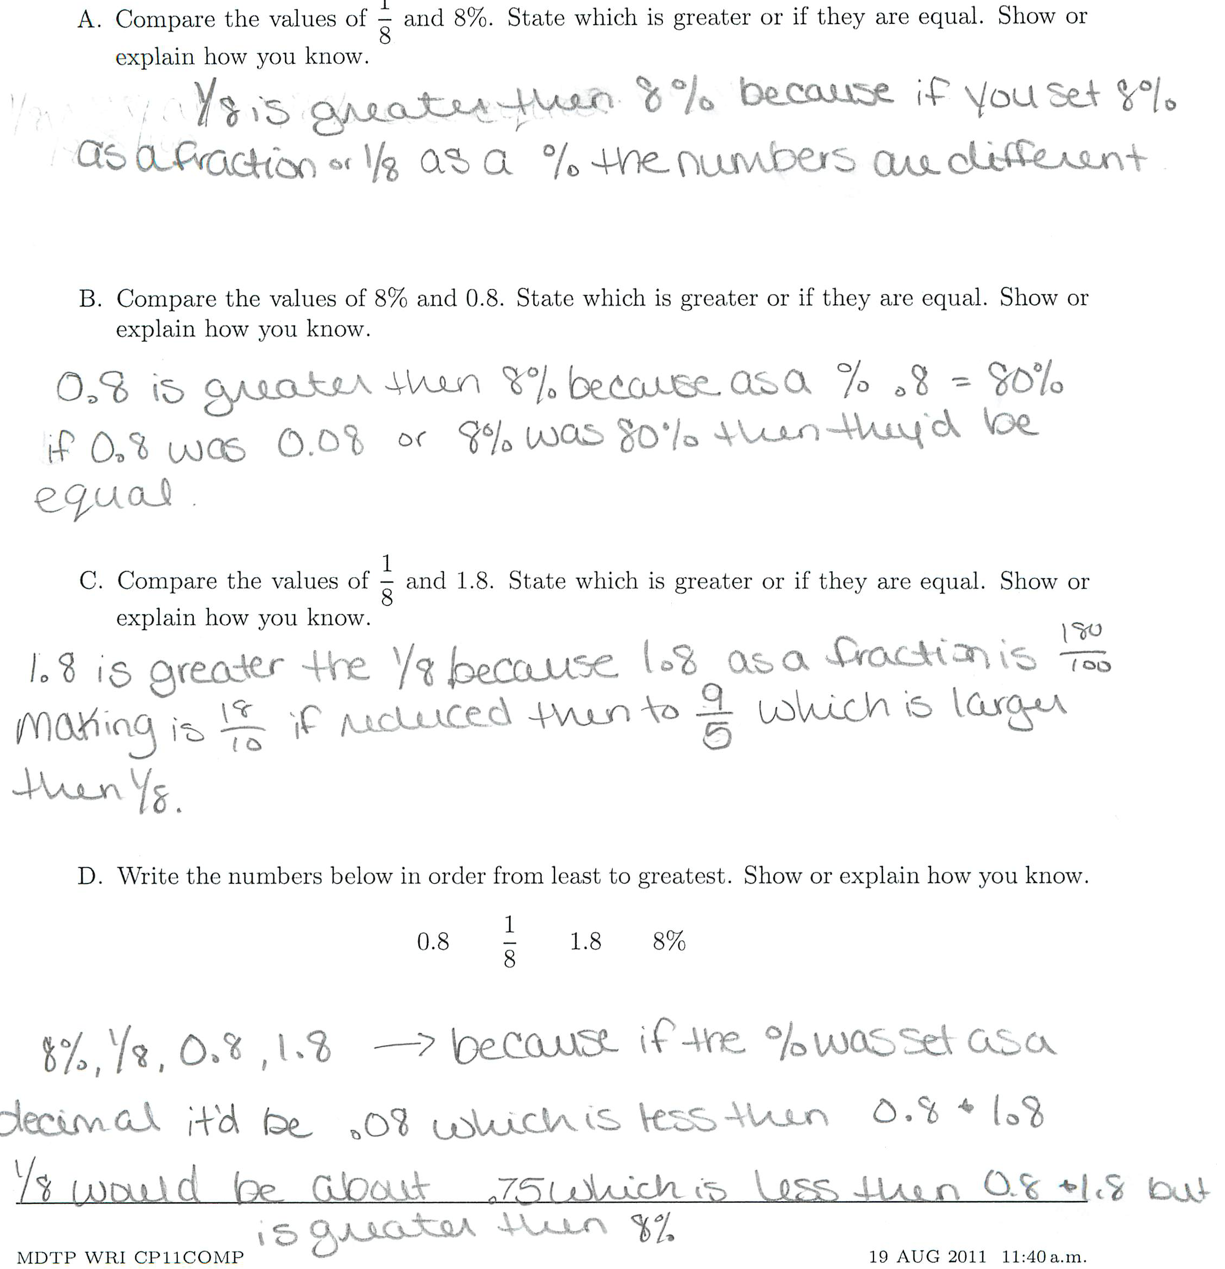
Notes:
Refer to AR12COMP Student Work handout.
Use the Specific Rubric to score this student’s work. Refer to the two rubric notes.
Do you agree with this teacher’s score? Why?
Consider scoring student work using specific and general rubrics with a colleague. Or allow students to score their own work using the specific rubric and give them an opportunity to rewrite some of their responses.
Collect student work. Keep exemplars. Record results to show growth.

Slide 12
CCSS Mathematical Practices
REASONING AND EXPLAINING
2. Reason abstractly and quantitatively
3. Construct viable arguments and critique the reasoning of others
OVERARCHING HABITS OF MIND
1. Make sense of problems and persevere in solving them
6. Attend to precision
MODELING AND USING TOOLS
4. Model with mathematics
5. Use appropriate tools strategically
SEEING STRUCTURE AND GENERALIZING
7. Look for and make use of structure
8. Look for and express regularity in repeated reasoning

Slide 13
Written Response Items and Standards for Mathematical Practice
Written Response Items mostly address
SMP 1 and 6 (Overarching Habits of Mind)
Make sense of problems and persevere in solving them
Attend to precision
SMP 2 and 3 (Reasoning and Explaining)
Reason abstractly and quantitatively
Construct viable arguments and critique the reasoning of others
Notes:
Some written response items address to a lesser extent the Modeling and Using Tools standards (SMP 4 and 5) and the Seeing Structure and Generalizing standards (SMP 7 and 8).

Slide 14
Standard 1: Make sense of problems and persevere in solving them
Understand the meaning of a problem and look for entry points to its solution.
Analyze givens, constraints, relationships, and goals.
Make conjectures about the form and meaning of the solution and plan a solution pathway rather than simply jumping into a solution attempt.
Consider analogous problems, and try special cases and simpler forms of the original problem in order to gain insight into its solution.
Monitor and evaluate their progress and change course if necessary.
Explain correspondences between equations, verbal descriptions, tables, and graphs and draw diagrams of important features and relationships, graph data, and search for regularity or trends.
Check their answers to problems using a different method, and continually ask themselves, “Does this make sense?”
Understand the approaches of others to solving complex problems and identify correspondences between different approaches.
Notes:
Refer to AR12COMP Essence Statement. Students are required to know when and how to convert among fraction, decimal, and percent representations. The problem also requires comparing rational numbers in the same representation.

Slide 15
Standard 6: Attend to precision
Communicate precisely to others.
Use clear definitions in discussion with others and in their own reasoning.
State the meaning of the symbols they choose, including using the equal sign consistently and appropriately.
Careful about specifying units of measure, and labeling axes to clarify the correspondence with quantities in a problem.
Calculate accurately and efficiently, express numerical answers with a degree of precision appropriate for the problem context.
Examine claims and make explicit use of definitions.
Notes:
Refer to AR12COMP Master Copy of problem instructions. Students were asked to clearly show how they solved each part, labeling any figures they drew.
Refer to example of student work for AR12COMP. This student was evaluated as a ‘2’ using the Specific Rubric primarily because of her inattention to precision in responding to “Show or explain how you know” for each part.

Slide 16
Standard 2: Reason abstractly and quantitatively
Make sense of quantities and their relationships in problem situations.
Decontextualize: abstract a given situation and represent it symbolically and manipulate the representing symbols.
Contextualize: pause as needed during the manipulation process in order to probe into the referents for the symbols involved.
Create a coherent representation of the problem at hand; considering the units involved; attending to the meaning of quantities, not just how to compute them; and know and flexibly use different properties of operations and objects.
Notes:
Refer to AR12COMP problem. In part C, a student might have (successfully) argued that 1.8 is greater than 1/8 because it is greater than 1 and 1 is greater than 1/8. This is an example of making sense of quantities without solely relying on an algorithm to solve the problem.

Slide 17
Standard 3: Construct viable arguments and critique others’ reasoning
Understand and use stated assumptions, definitions, and previously established results in constructing arguments.
Make conjectures and build a logical progression of statements to explore the truth of their conjectures.
Analyze situations by breaking them into cases, and can recognize and use counterexamples.
Justify their conclusions, communicate them to others, and respond to the arguments of others.
Reason inductively about data, making plausible arguments that take into account the context from which the data arose.
Compare the effectiveness of two plausible arguments, distinguish correct logic or reasoning from that which is flawed, and—if there is a flaw in an argument—explain what it is.
Listen or read the arguments of others, decide whether they make sense, and ask useful questions to clarify or improve the arguments.
Notes:
Refer to AR12COMP Essence Statement. To answer Part D students could have used their results from Parts A, B, and C.
Refer to AR12COMP Master Copy of problem. Students are asked to “clearly show how you solved each part” at the top of the page, and are asked to “Show or explain how you know” for each part.

Slide 18
Using Written Response Items to Help Teach Standards for Mathematical Practice
First work problem yourself and read Essence Statement to understand topic area and purpose of problem.
Think about other solutions and anticipate student errors.
Make copies of Master Copy of Problem and distribute to students.
Provide guidance about showing work, use of diagrams, and justification.
Provide enough time for students to think about the item and to carefully respond to each part.
Consider scoring student work using specific and general rubrics with a colleague, or allow students to score their own work using the specific rubric and give them an opportunity to rewrite some of their responses.
Collect student work, keep exemplars, and record results to show growth.

Slide 19
Related Resources for Teaching SMP
CCSS Implementation Videos (The Importance of Mathematical Practices): http://www.youtube.com/watch?v=m1rxkW8ucAI&list=PLD7F4C7DE7CB3D2E6&index=5
Illustrative Mathematics “Standards for Mathematical Practice”: http://www.illustrativemathematics.org/standards/practice
SERP “The CCSS and their Potential Impact on our Teaching”: http://math.serpmedia.org/tools_ccss.html
Number Talks in High School: Dilemmas and Successes: http://numbertalks1.blogspot.com/

