Slide 1

Math Games that Encourage CC Math Practices
Presented by Mary Curry
Mary@mangomath.com
www.mangomath.com
Notes:
Introduce yourself and 1 word that you would use to describe math

Slide 2
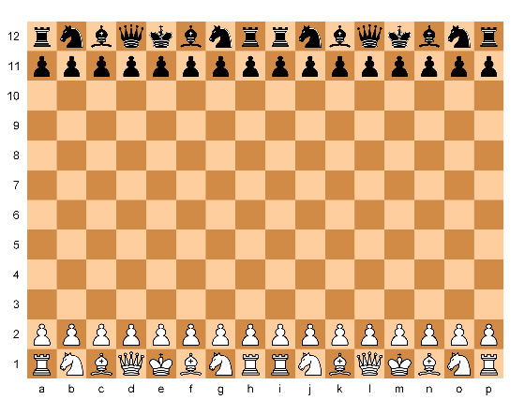
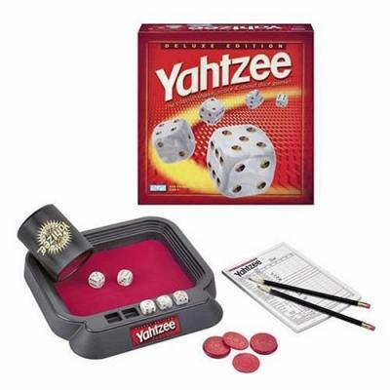
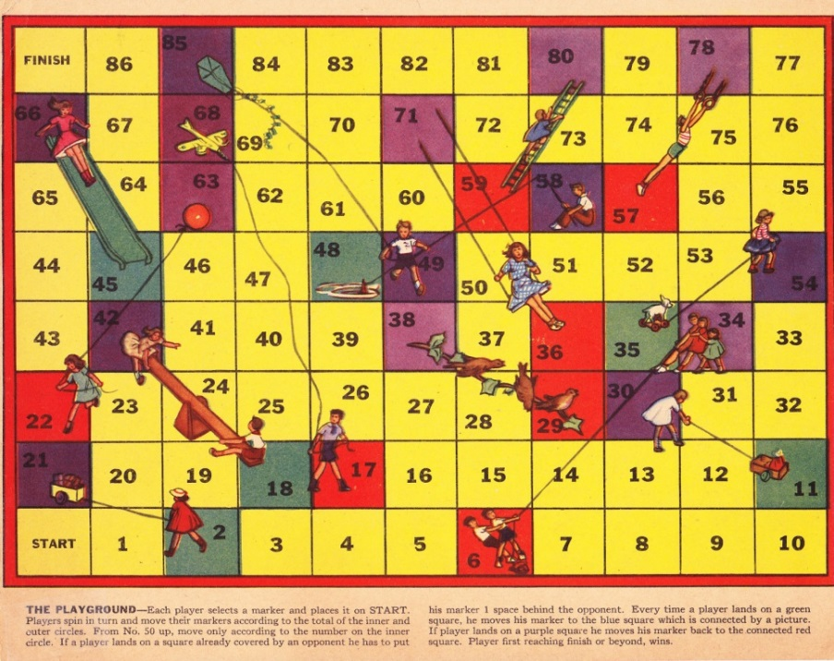
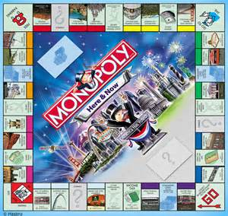
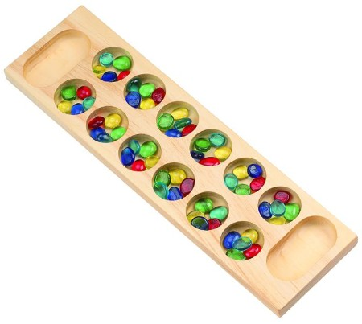

Why Math Games?

Slide 3
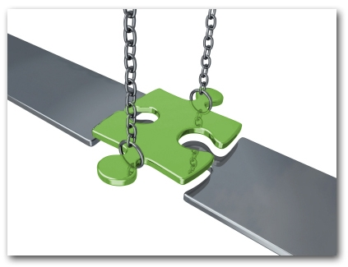
closes the achievement gap in minority schools

Slide 4
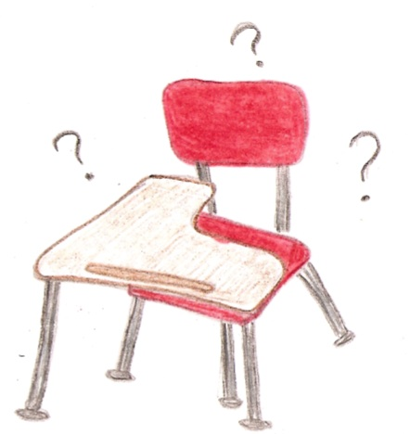
Absentee rates dropped in middle and high schools where math games are played in conjunction with regular math class.

Slide 5
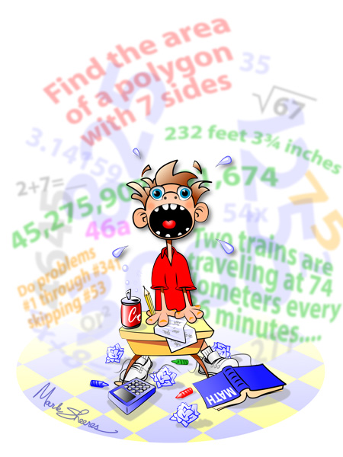
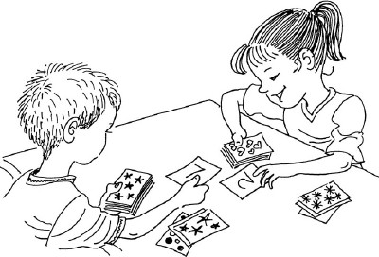
Reduces Stress

Slide 6


math

Slide 7

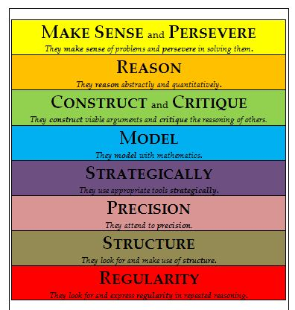

Slide 8
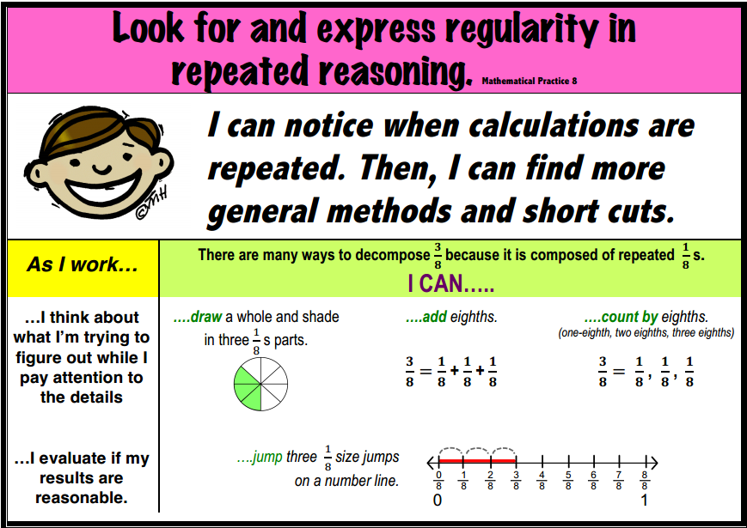

Slide 9
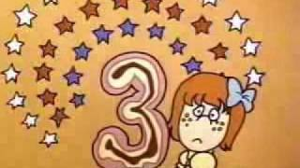
Repeated Reasoning with Multiplication
9s –
    9 x 1 = 09
    9 x 2 = 18
    9 x 3 = 27
    9 x 4 = 36
    9 x 5 = 45
    9 x 6 = 54
    9 x 7 = 63
    9 x 8 = 72
    9 x 9 = 81
    9 x 10 = 90
Start with 0 & 1
2s - doubles
10s – x 1 add 0
5s – ½ 10, even end in 0, odds end in 5
3s – Magic Number
4s – double, double: 4 x 7,
  double 7 = 14, double 14 = 28

Slide 10
Multiplication Chart
x | 0 | 1 | 2 | 3 | 4 | 5 | 6 | 7 | 8 | 9 | 10
0 | 0 | 0 | 0 | 0 | 0 | 0 | 0 | 0 | 0 | 0 | 0
1 | 0 | 1 | 2 | 3 | 4 | 5 | 6 | 7 | 8 | 9 | 10
2 | 0 | 2 | 4 | 6 | 8 | 10 | 12 | 14 | 16 | 18 | 20
3 | 0 | 3 | 6 | 9 | 12 | 15 | 18 | 21 | 24 | 27 | 30
4 | 0 | 4 | 8 | 12 | 16 | 20 | 24 | 28 | 32 | 36 | 40
5 | 0 | 5 | 10 | 15 | 20 | 25 | 30 | 35 | 40 | 45 | 50
6 | 0 | 6 | 12 | 18 | 24 | 30 | 6 x 6 |  |  | 54 | 60
7 | 0 | 7 | 14 | 21 | 28 | 35 | 6 x 7 | 7 x 7 |  | 63 | 70
8 | 0 | 8 | 16 | 24 | 32 | 40 | 6 x 8 | 7 x 8 | 8 x 8 | 72 | 80
9 | 0 | 9 | 18 | 27 | 36 | 45 | 54 | 63 | 72 | 81 | 90
10 | 0 | 10 | 20 | 30 | 40 | 50 | 60 | 70 | 80 | 90 | 100

Slide 11
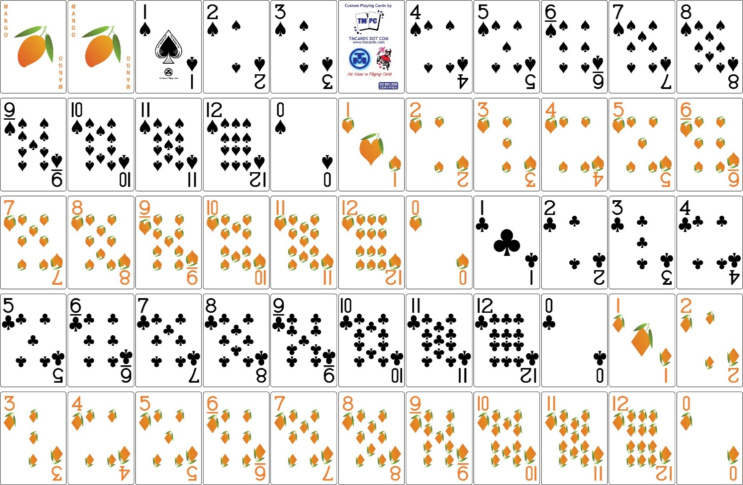

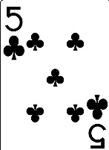

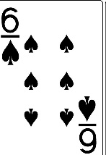
Cue

Slide 12

Cue

Slide 13
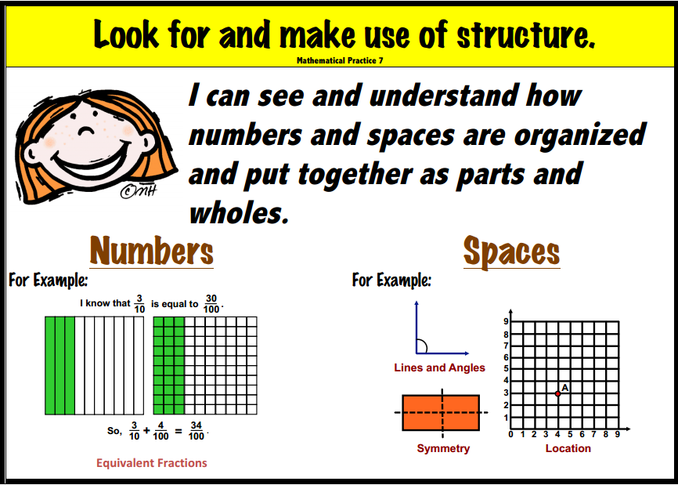

Slide 14
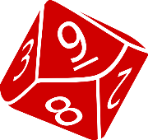

Got Room
1
x
6
=
6
6 x 9 = 54
9 x 6 = 54
8 x 3 = 24
4 x 6= 24
6 x 6= 36
2 x 3 = 6

Slide 15
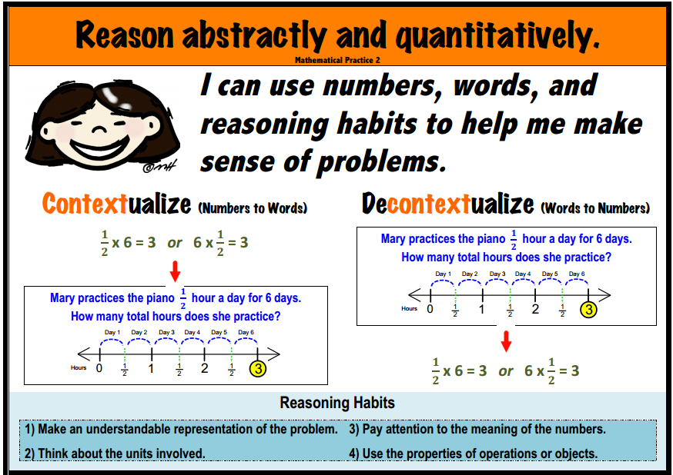

Slide 16
Quiz
Who eats Green Eggs and Ham?
Sam I Am
After the box, where can he eat them?
With a fox
Before the box, where can he eat them?
With a mouse
What letter comes after P in the alphabet?
Q
What letter comes before H?
G
What letter comes two before Q?
O

Slide 17
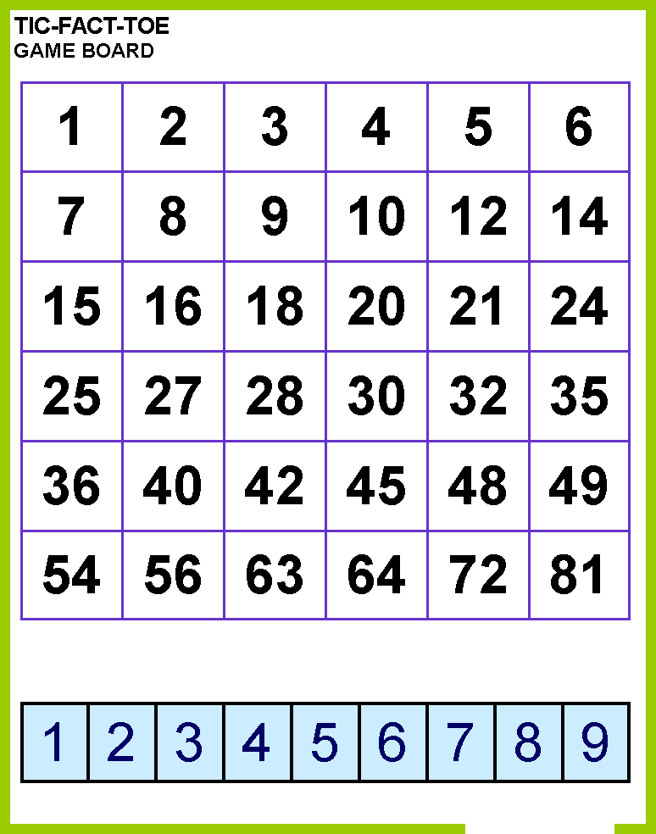

Slide 18
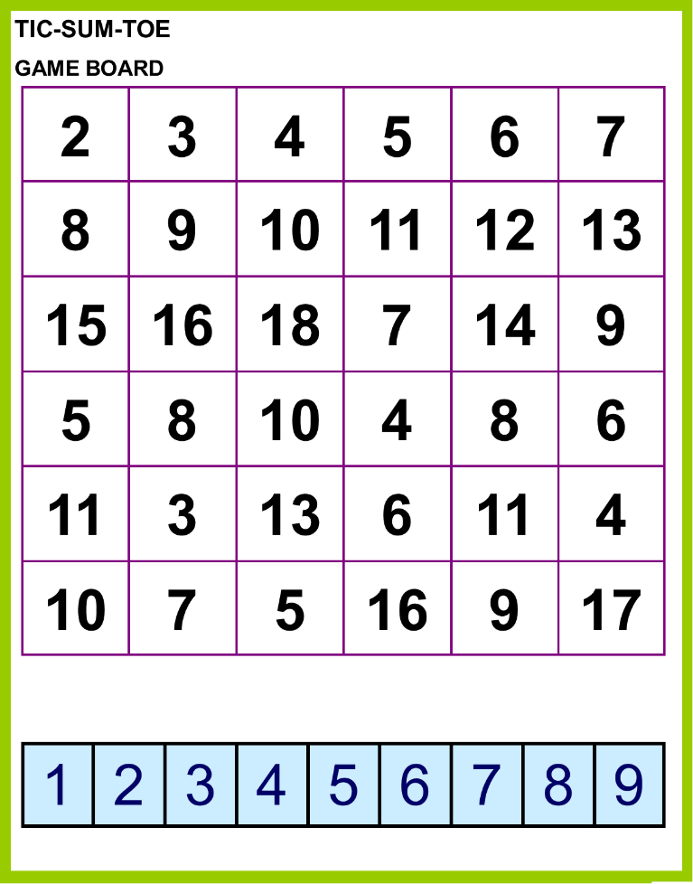

Slide 19
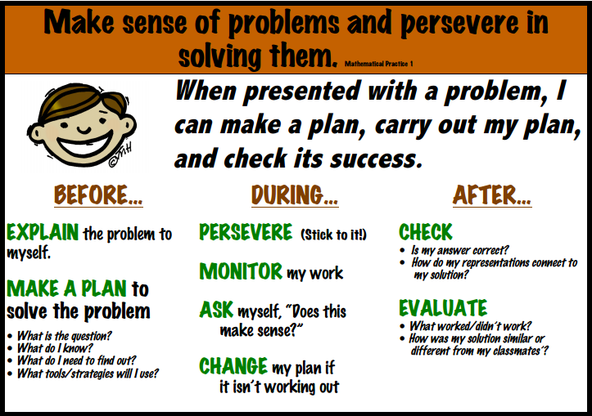

Slide 20
4 Way Shuffle
3 6

Slide 21
4 Way Shuffle
9 0

Slide 22
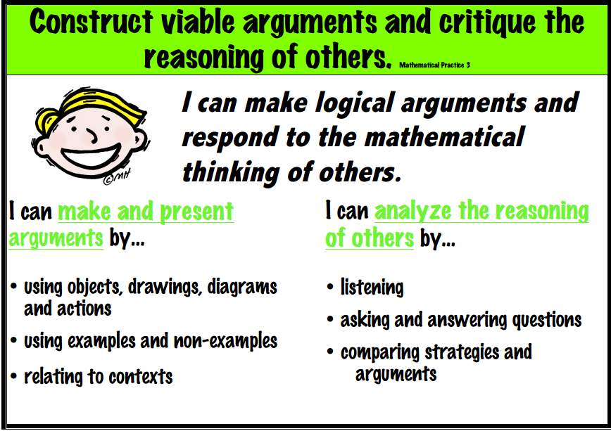

Slide 23
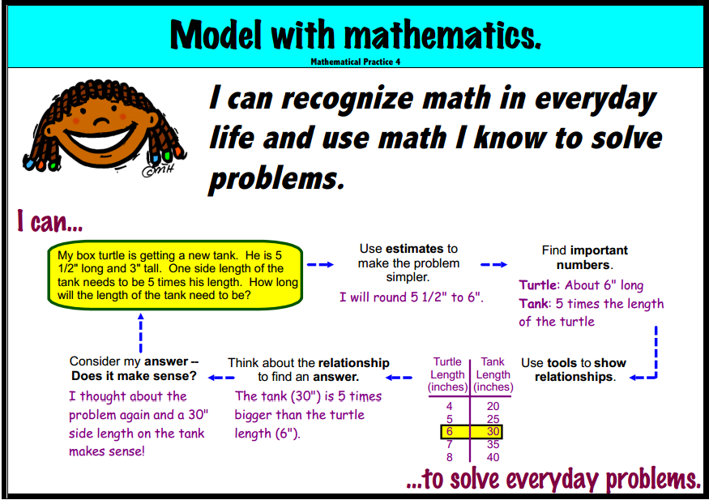

Slide 24
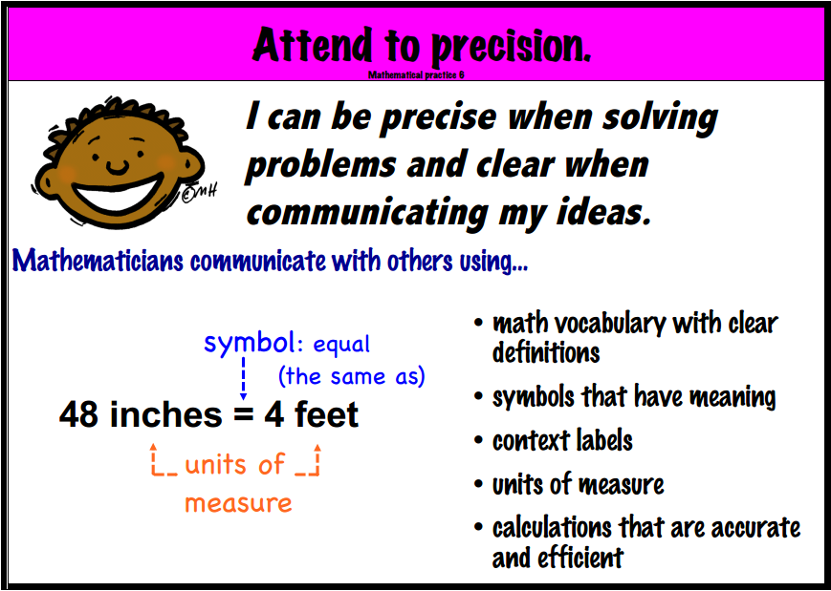

Slide 25
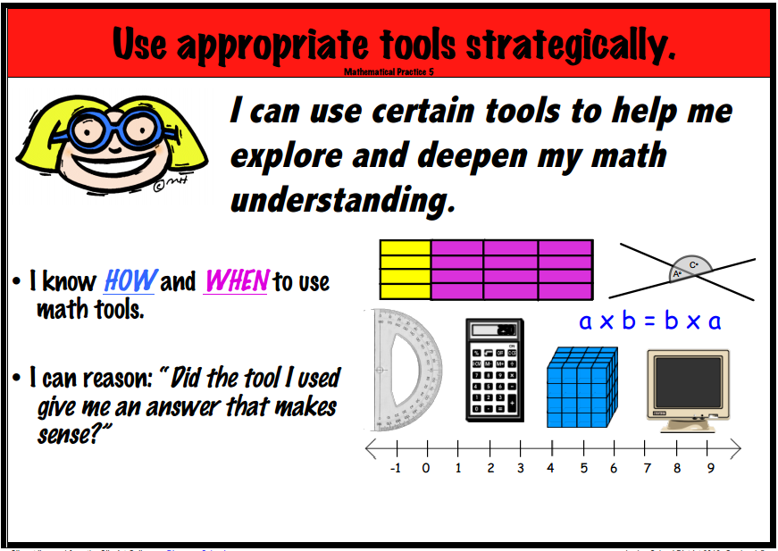

Slide 26

Mary@mangomath.com
or 425-328-1024

