Slide 1
Conditional Probability and Independence in the Common Core
CMC Annual Conference
Palm Springs, CA
November, 2013
Josh Tabor
Canyon del Oro High School
joshtabor@hotmail.com

Slide 2
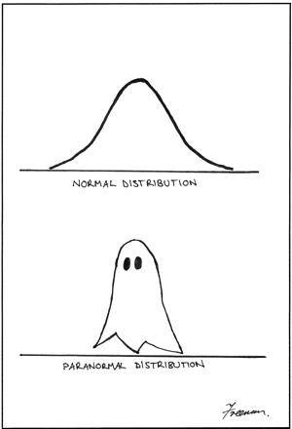

Slide 3
From the Common Core State Standards
Conditional Probability and the Rules of Probability (S-CP)
Understand independence and conditional probability and use them to interpret data
 | 1. Describe events as subsets of a sample space (the set of outcomes) using characteristics (or categories) of the outcomes, or as unions, intersections, or complements of other events (“or,” “and,” “not”).
 | 2. Understand that two events A and B are independent if the probability of A and B occurring together is the product of their probabilities, and use this characterization to determine if they are independent.
 | 3. Understand the conditional probability of A given B as P(A and B)/P(B), and interpret independence of A and B as saying that the conditional probability of A given B is the same as the probability of A, and the conditional probability of B given A is the same as the probability of B.

Slide 4
From the Common Core State Standards
Conditional Probability and the Rules of Probability (S-CP)
Understand independence and conditional probability and use them to interpret data
 | 4. Construct and interpret two-way frequency tables of data when two categories are associated with each object being classified. Use the two-way table as a sample space to decide if events are independent and to approximate conditional probabilities.
 | 5. Recognize and explain the concepts of conditional probability and independence in everyday language and everyday situations.

Slide 5
From the Common Core State Standards
Use the rules of probability to compute probabilities of compound events in a uniform probability model
 | 6. Find the conditional probability of A given B as the fraction of B’s outcomes that also belong to A, and interpret the answer in terms of the model.
 | 7. Apply the Addition Rule, P(A or B) = P(A) + P(B) – P(A and B), and interpret the answer in terms of the model.
 | (+) 8. Apply the general Multiplication Rule in a uniform probability model, P(A and B) = P(A)P(B|A) = P(B)P(A|B), and interpret the answer in terms of the model.
 | (+) 9. Use permutations and combinations to compute probabilities of compound events and solve problems.

Slide 6
Two-Way Tables and the General Addition Rule (S-CP.1, 4, 7)
Free Tacos!
In 2012, fans at Arizona Diamondbacks home games would win 3 free tacos from Taco Bell if the Diamondbacks scored 6 or more runs. In the 2012 season, the Diamondbacks won 41 of their 81 home games and gave away free tacos in 30 of their 81 home games. In 26 of the games, the D-backs won and gave away free tacos. Let W = win and T = free tacos. Choose a D-backs home game at random.

Slide 7
Free Tacos
(a) Summarize these data in a two-way table.
 | Win | Loss | Total
Tacos! | 26 | 4 | 30
No tacos | 15 | 36 | 51
Total | 41 | 40 | 81

Slide 8
Free Tacos!
(b) What is the probability that the D-backs win?
P(Win) = 41/81
(c) What is the probability that there are free tacos?
P(Taco) = 30/81

Slide 9
Free Tacos!
(d) What is the probability that the D-backs win and there are free tacos?
P(Win and Taco) = 26/81
(e) What is the probability that the D-backs win or there are free tacos?
P(Win or Taco) = 41/81 + 30/81 – 26/81
= 45/81

Slide 10
Free Tacos!
(f) What is the General Addition Rule?
(see S-CP.7)
P(A or B) = P(A) + P(B) – P(A and B)

Slide 11
Conditional probability and independence (S-CP.3–6)
More Tacos!
(g) What is the probability that there are free tacos, given that the D-backs won the game?
P(Tacos | Win) = 26/41

Slide 12
Free Tacos!
(h) What is the probability that the D-backs win the game, given that there were free tacos?
P(Win | Taco) = 26/30
(i) What is a conditional probability? What notation do we use? Is there a formula?
$$P\left(A \right|B)= \frac{P(A and B)}{P(B)}=\frac{P(both)}{P(given)}$$

Slide 13
Free Tacos!
(j) When are two events independent?
If two events are independent, then knowing the outcome of one event does not help us predict the outcome of the other event.

Slide 14
Free Tacos!
(j) Are the events “D-backs win” and “Free tacos” independent? Justify.
Does knowing the D-backs won help us predict if there will be free tacos? YES!
P(taco | win) = 26/41 = 0.63
P(taco | no win) = 4/40 = 0.10
P(taco) = 30/81 = 0.37

Slide 15
Free Tacos!
(j) When are two events independent?
(see S-CP.3)
If A and B are independent events,
P(A | B) = P(A | B^{C}) = P(A)
and vice-versa…

Slide 16
Bonus Question!
How can we “see” independence?
Actual: If independent:

Slide 17
Gender and Handedness
It’s your turn…

Slide 18
Gender and Handedness
 | Male | Female | Total
Right | 9 | 8 | 17
Left | 1 | 2 | 3
Total | 10 | 10 | 20

Slide 19
Gender and Handedness
(b) What is the probability that the student is female and right-handed?
P(F and R) = 8/20
(c) What is the probability that the student is female or right-handed?
P(F or R) = 10/20 + 17/20 – 8/20
= 19/20

Slide 20
Gender and Handedness
(d) Given that the student is female, what is the probability that she is right-handed?
P(R | F) = 8/10
(e) Are “selecting a female” and “selecting a right-hander” independent events? Justify.
P(R | F) = 8/10 = 0.80
P(R | M) = 9/10 = 0.90
P(R) = 17/20 = 0.85

Slide 21
Bonus Question
If gender and class status are independent, what is x?
 | Male | Female | Total
Freshman |  |  | 30
Sophomore |  |  | 25
Junior |  |  | 25
Senior | x |  | 20
Total | 40 | 60 | 100

Slide 22
Tree Diagrams, the General Multiplication Rule, and Independence (S-CP.1, 2, 8)
Serve It Up!
Tennis great Roger Federer made 63% of his first serves in the 2011 season. When Federer made his first serve, he won 78% of the points. When Federer missed his first serve and had to serve again, he won only 57% of the points. Suppose we randomly choose a point on which Federer served.

Slide 23
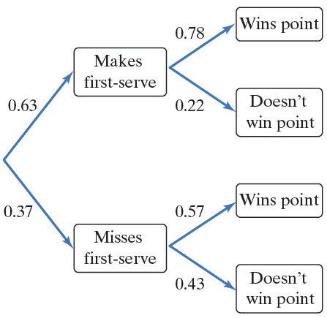
Serve it Up!
(a) Display this chance process with a tree diagram.

Slide 24
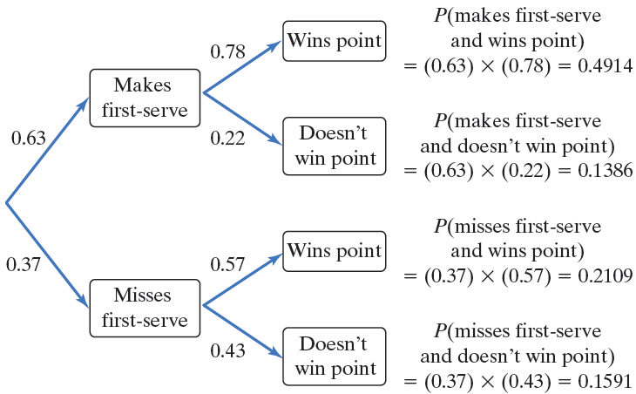
Serve it Up!
(b) What is the probability that Federer makes his first serve and wins the point?

Slide 25
Serve it Up!
(c) What is the General Multiplication Rule? What if the two events are independent?
P(A and B) = P(A) x P(B | A)
If A and B are independent,
P(A and B) = P(A) x P(B)

Slide 26
Serve it Up!
(d) What is the probability that Federer wins the point?
P(Win) = P(Win | made first serve) +
P(Win | missed first serve)
= 0.4914 + 0.2109
= 0.7023

Slide 27
Serve it Up!
(e) Given that Federer won the point, what is the probability that he missed his first serve?
P(miss 1st | won point) = $\frac{P(miss and won)}{P(won)}$
= $\frac{0.2109}{0.7023}$ = 0.30

Slide 28
False Positives and Drug Testing
Many employers require prospective employees to take a drug test. A positive result on this test indicates that the prospective employee uses illegal drugs. However, not all people who test positive actually use drugs. Suppose that 4% of prospective employees use drugs, the false positive rate is 5%, and the false negative rate is 10%. Select one prospective employee at random.

Slide 29
False Positives and Drug Testing
(a) Would it be better to use a tree diagram or a two-way table to summarize this chance process?

Slide 30
False Positives and Drug Testing
It’s your turn…
(b) What percent of prospective employees will test positive?
P(+) = P(+ and drugs) + P(+ and no drugs)
= (0.04)(0.90) + (0.96)(0.05)
= 0.036 + 0.048
= 0.084

Slide 31
False Positives and Drug Testing
It’s your turn…
(c) What percent of prospective employees who test positive actually use illegal drugs?
P(drugs | +) = $\frac{P(drugs and+)}{P(+)}$
= $\frac{0.036}{0.084}$ = 0.43
Evaluations: Session #364

