Slide 1
Geometry CCSS: Translations , Reflections, Rotations , Oh My!
Janet Bryson & Elizabeth Drouillard
CMC 2013

Slide 2
What does CCSS want from us in High School Geometry?
The expectation in Geometry is to understand that rigid motions are at the foundation of the definition of congruence.
Students reason from the basic properties of rigid motions (that they preserve distance and angle), which are assumed without proof.
Rigid motions and their assumed properties can be used to establish the usual triangle congruence criteria, which can then be used to prove other theorems.

Slide 3
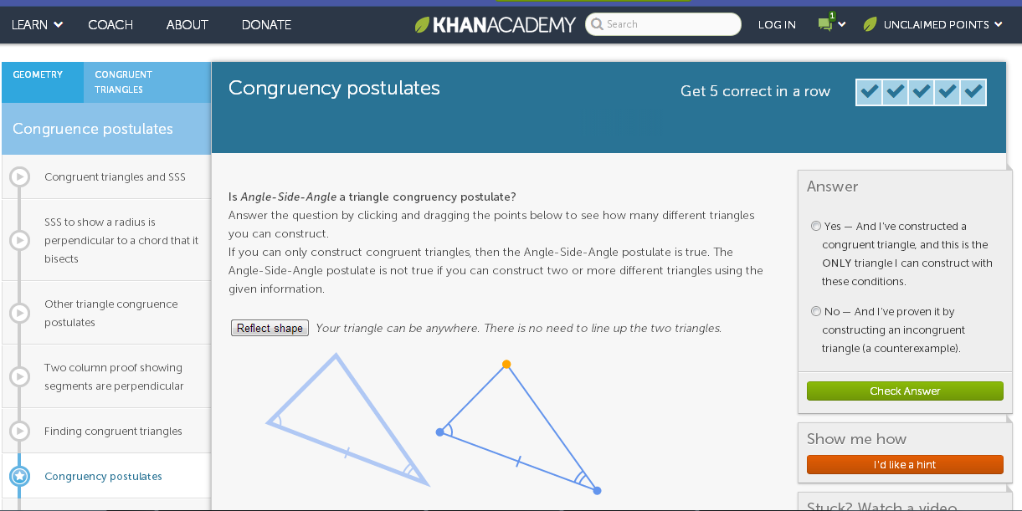
Congruence Theorems/Postulates
https://www.khanacademy.org/math/geometry/congruent-triangles/cong_triangle/e/congruency_postulates

Slide 4
Exploring Reflections
Questions:
1) Where is the mirror line located when the reflection and original figure intersect at a point?
2) Where is the mirror line located when the reflection and original figure overlap?
3) Can the mirror line be moved in such a way that the reflection and original are the same figure
(identical, overlapped)?
http://www.maa.org/sites/default/files/images/upload_library/47/Crowe/GeoGebra_Activity_1.html

Slide 5
Using transformations in proofs:
The expectation is to build on student experience with rigid motions from earlier grades.
Rigid motion transformations:
Map lines to lines, rays to rays, angles to angles, parallel lines to parallel lines
preserve distance, and
preserve angle measure.
Rotation of t° around point M
rotations move objects along a circular arc with a specified center through a specified angle.
Reflection across line L
If point A maps to A’, then L is the perpendicular bisector of segment A’
Translation
translations move points a specified distance along a line parallel to a specified line.

Slide 6
Assumptions
2 points determine exactly 1 line
Parallel Postulate: uniqueness
…
$\begin{matrix}|AB|=|BA| \\ \text{If} |AB|=0, \text{then} \text{A}\text{=}\text{B} \\ \text{If} \text{C} \text{is} \text{between} \text{A} \text{\&} \text{B}\text{, }\text{then} |AC|+|CB|=|AB| \\ {\text{If} \text{C} \text{is} \text{on} \text{Ray}}_{AB},\text{and} |AC|=|AB|, \text{then} \text{B}\text{=}\text{C}\end{matrix}$
0 $≤|\text{∠}\text{AOB}|<360°, ≤|\text{∠}\text{AOB}|$=$0°,$Ray_{OA} = Ray_{OB}
$\text{∠}\text{AOB}|<180°$, then $\text{}\text{AOB} ,$ then $\text{}\text{AOB}$ is a straight angle.
If $\text{}\text{AOC}$ and $\text{}\text{C}\text{OB}$ are adjacent (A & B on opposite sides of OC), then $\text{}\text{AOC}$ + $\text{}\text{COB}$=$\text{}\text{AO}$B
Basic rigid motions map lines to lines, angles to angles, and parallel lines to parallel lines

Slide 7
Theorems
180° rotation around a point maps line L to a line parallel to L
Let it be noted explicitly that the CCSSM do not pursue transformational geometry per se. Geometric transformations are merely a means to an end: they are used in a strictly utilitarian way to streamline and shed light on the existing school geometry curriculum. For example, once reflections, rotations, reflections, and dilations have contributed to the proofs of the standard triangle congruence and similarity criteria (SAS, SSS, etc.), the development of plane geometry can proceed in the usual way if one so desires.
Q

Slide 8
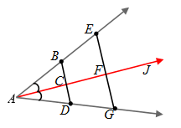
Angle Bisector

Slide 9
Congruence Theorems: Illuminations
Theorem | Does it prove ? | Sketch
ASA
SAS
SSS
SSA
AAA
http://illuminations.nctm.org/ActivityDetail.aspx?id=4

Slide 10
SAS Congruence Using Transformations

Slide 11
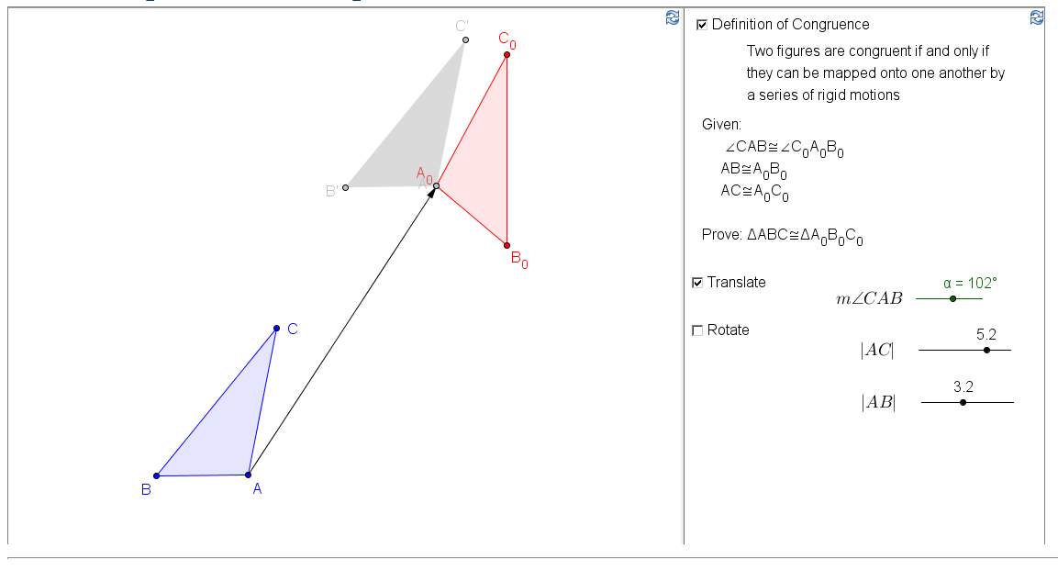
SAS Congruence Using Transformations

Slide 12
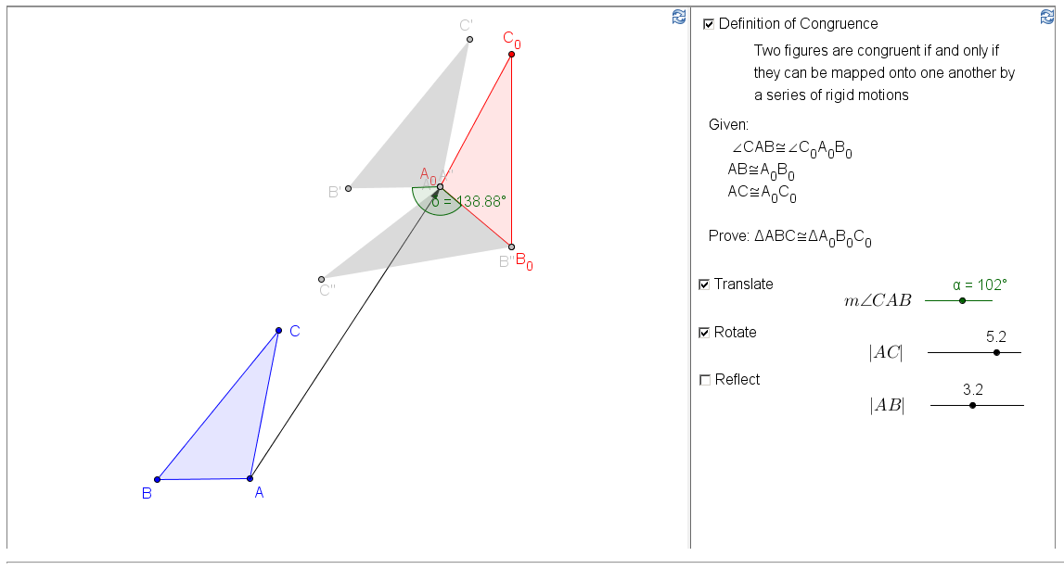
SAS Congruence Using Transformations

Slide 13
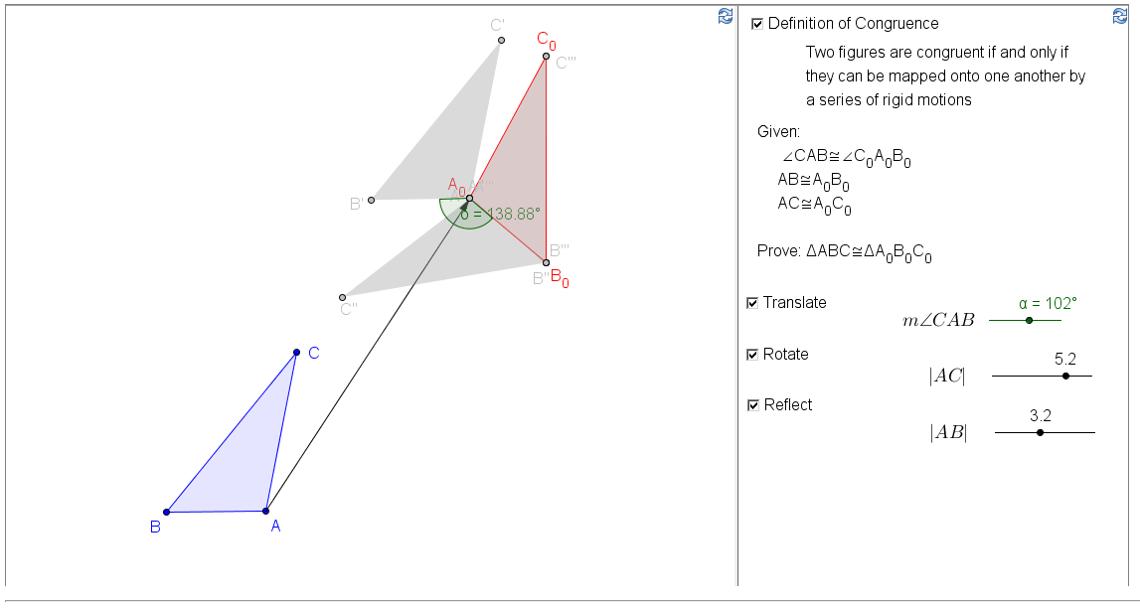
SAS Congruence Using Transformations

Slide 14
G.SRT.1a
Given a center and a scale factor, verify experimentally, that when dilating a figure in a coordinate plane, a segment of the pre-image that does not pass through the center of the dilation, is parallel to it’s image when the dilation is preformed. However, a segment that passes through the center remains unchanged.
G.SRT.1b
Given a center and a scale factor, verify experimentally, that when performing dilations of a line segment, the pre-image, the segment which becomes the image is longer or shorter based on the ratio given by the scale factor.

Slide 15
Links for resources &
interactive activities
https://www.khanacademy.org/math/geometry/congruent-triangles/cong_triangle/e/congruency_postulates
http://illuminations.nctm.org/ActivityDetail.aspx?id=4
http://www.engageny.org/resource/geometry-module-1
http://www.maa.org/publications/periodicals/loci/resources/exploring-geometric-transformations-in-a-dynamic-environment-description
http://www.maa.org/sites/default/files/images/upload_library/47/Crowe/GeoGebra_Activity_1.html
http://www.maa.org/sites/default/files/images/upload_library/47/Crowe/Exploring_Geometry_Transformations.pdf
http://www.illustrativemathematics.org/standards/hs

Slide 16
Links for resources &
interactive activities
http://www.geogebratube.org/student/m42641 SAS Congruence
http://www.illustrativemathematics.org/illustrations/1509
http://www.ncpublicschools.org/docs/acre/standards/common-core-tools/unpacking/math/geometry.pdf#page=1&zoom=auto,0,620
Teaching Geometry According to the Common Core Standards
http://math.berkeley.edu/~wu/Progressions_Geometry_2013.pdf

