Slide 1

A Vehicle for Transformation
Sunny Chin-Look, NBCT
K-8 Math Instructional Specialist
Alhambra Unified School District

Slide 2

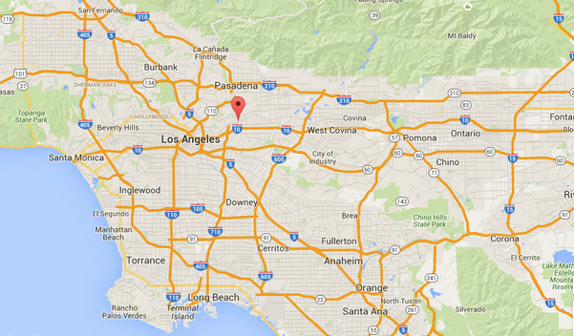
Population: 17,617
Asian: 50%, Hispanic/Latino: 42%
SED: 70%
13 K-8 Elem, 4 HS

Slide 3


14-15 District SBAC Proficiency
ELA: 58%, Math: 50%

Slide 4
Trainings Transfer
≠
Covering vs. Uncovering
Teaching vs. Learning
Flying Solo vs. Collaboration
Congenial vs. Collegial
Assessing for Grading vs. Collecting Evidence of/for Learning
Test Prep Mentality

Slide 5


Theoretical Framework
Understanding by Design (UbD)

Slide 6
3 Stage Backward Planning
(Wiggins and McTighe, Authentic Education)
Identify desired results
Determine acceptable evidence
Plan learning experiences and instruction
Notes:
Design strategy is called backward design. Ways to avoid self-deception. See the handout.
District Unit of study math template.

Slide 7
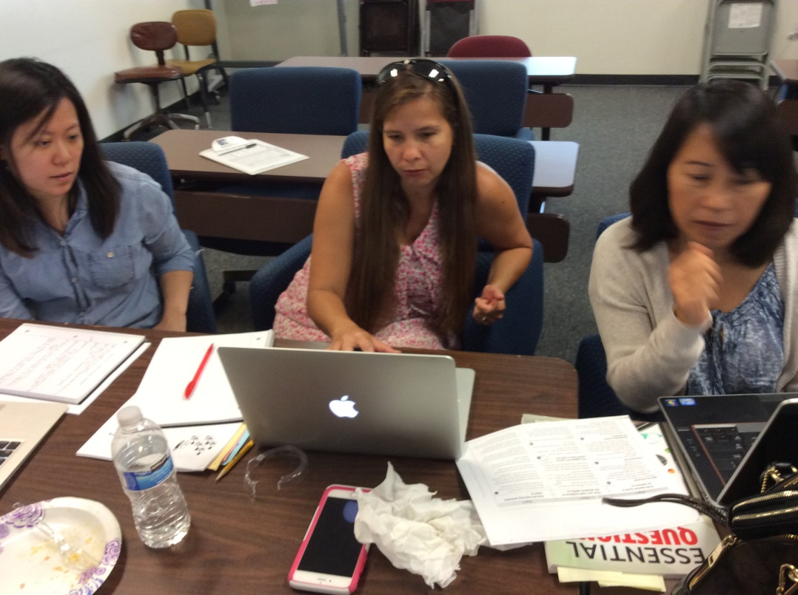
Units of Study Cadres
District IS UbD Training
Summer Cadre Training
Units of Study Cadre Meetings (lesson study)
Site Collaboration Training
Content Training

Slide 8





Out-of-date
benchmark
Lesson Planning Relationship

