Slide 1
Effects of Group Project on Students’ Learning and Attitude
Action Research Project
By
Sohayla M. Lajevardi
2013

Slide 2
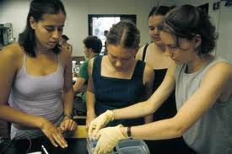
Research Question
Using pretest/post-test design, does mathematics instruction involving group projects during class time increase students’ achievement in understanding the relationship between similar triangles and proportions?
http://serc.carleton.edu/images/cismi/broadaccess/bio_lab_group_2.jpg

Slide 3
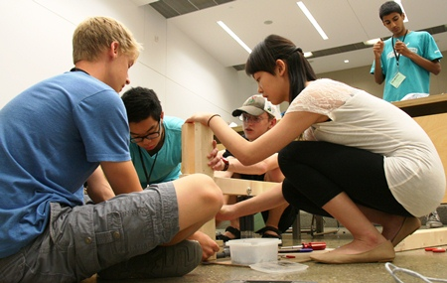
Introduction Why do we need to make the content more relevant to students’ lives:
Student motivation
Student engagement
Students’ attitude toward their own learning
purpose of learning math
http://www.engineering.ualberta.ca/NewsEvents/Engineering%20News/2012/August/Programprovidesreal-lifeengineeringchallenges.aspx

Slide 4
Literature Review What previous researches revealed
Sullivan, Clark, and Clark (2009) note “One of the paradoxes facing those whose task it is to support mathematics teachers is that, while the availability and accessibility of interesting teaching ideas is steadily increasing, the challenge of converting those ideas to successful student learning is as substantial as ever” (p. 85).

Slide 5
Literature Review Continued, What previous researches revealed
Vygotsky as cited by Marshall et al.(2007) argues that when students participate in group activity projects, “Students go beyond learning facts, rules, algorithms, and procedures in order to become critical thinkers and problem- solvers” (p. 576).
http://www.schoolimprovement.com/common-core-360/blog/common-core-problem-solvers/

Slide 6
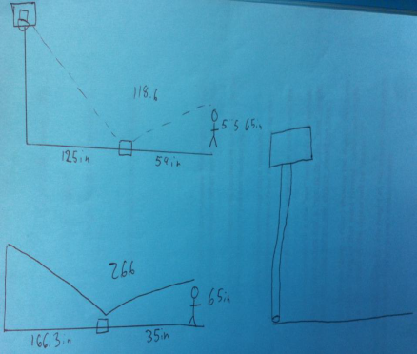
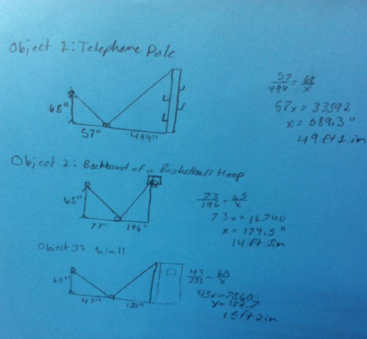
Method
Students took the pre-test
Students studied the properties of similar polygons
Students got into groups of three and measured the height of a few tall objects by applying their knowledge of similar triangle and using a mirror and a measuring tape.
Students took a post-test
Students reflected on their experienced using a survey I had designed.

Slide 7
Results
According to the students’ responses on the survey:
students enjoyed working in groups with their peers because they were able to help each other in a nonthreatening way. Students acknowledged their enjoyment of learning math concepts outside of the classroom in an open area.
students appreciated learning the content outside of the classroom in an open area where they were able to physically move around and engage in an activity.
students benefited from the hands-on experiment and from using the realm objects.
They will more likely remember this topic as they can relate it to their life experiences.

Slide 8
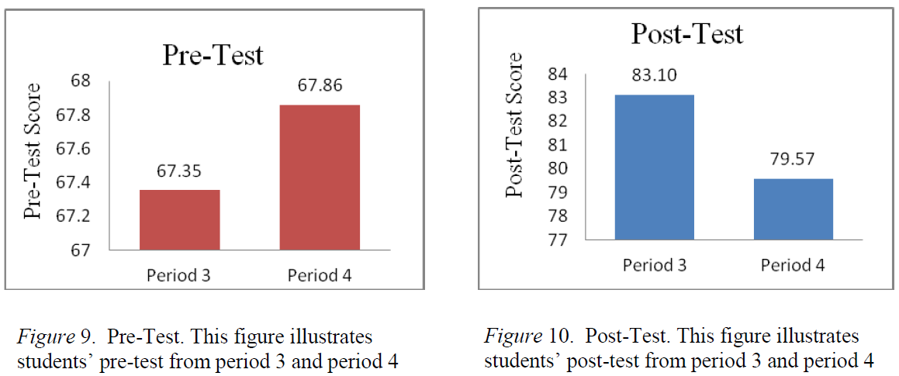
Results Continued

Slide 9
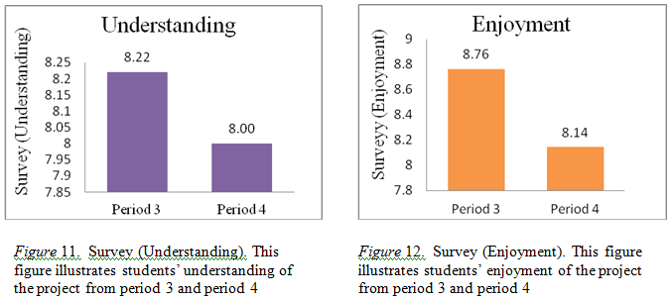
Results Continued

Slide 10
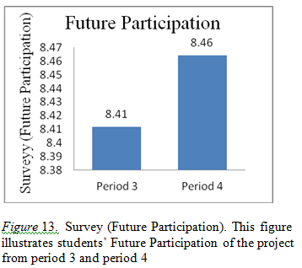
Results Continued

Slide 11
Pearson Correlation was performed using SPSS 19
There were several strong positive interconnections observed from this analysis:
There exists a strong correlation between the students’ understanding and post-test (r (62) = .379, p<.05).
Students’ understanding correlates greatly with their enjoyment of the project (r (62) = .391, p <.05).
Students’ enjoyment shows substantial correlation with their future participation ( r (62) = .805, p < .05).
Students’ understanding strongly correlates with their future participation (r (62) = .506, p < .05).

Slide 12
Conclusion
Upon completion of this project, it became evident that the students’ performance on the assessments of similar triangles and proportions, and their attitudes and interest toward this content improved as a result of the group project, which was executed during class time outside of the classroom.
https://encrypted-tbn3.gstatic.com/images?q=tbn:ANd9GcQVCyc5Z6UYtRngbYI-bOWUJFJjBh5dGDg6qrr0_ijnB8IIeTq52w

Slide 13
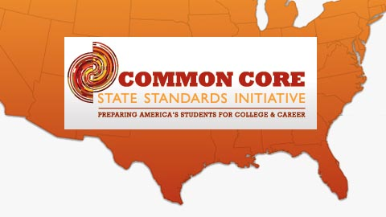
Adoption of Common Core Standards
Real life experiences promote students’ reasoning, sense making, and conceptual understanding of the content.
Cooperative learning contributes to students’ motivation and mathematical discourse, and social interactions.
Inquiry based learning encourages students to persevere when solving problems and justify their reasoning.
http://www.ednewscolorado.org/wp-content/uploads/2010/07/StockCommCore72010.jpg

Slide 14
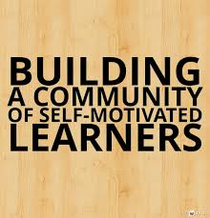
The primary objective of teachers of mathematics is to promote educational environments that cultivate students who are self-disciplined and self-motivated in their own learning. This community will help students develop team building skills, which will benefit them in the real world in the long run (St Clair & Tschirhart, 2002).
https://encrypted-tbn2.gstatic.com/images?q=tbn:ANd9GcSx0_Ulg3Rbpwvzl1q-nPA45uW-QMuc-CVZgXIUg90aUSaB3uLO

Slide 15
References
Marshall, J. , Horton, R. , Igo, B. , & Switzer, D. (2009). K-12 Science and mathematics teachers’ beliefs about and use of inquiry in the classroom.International Journal of Science and Mathematics Education, 7(3), 575-596.
St. Clair, L. , & Tschirhart, M. (2002). When and where? facilitating group work beyond the borders of the classroom. Journal of Management Education, 26(4), 449-461.
Sullivan, P., Clarke, D., & Clarke, B., (2009). Converting mathematics tasks to learning opportunities: An important aspect of knowledge for mathematics teaching. Mathematics Education Research Journal, 21(1), 58-105.

